Slide 1



DEPARTMENT OF ELECTRONICS & COMMUNICATION ENGINEERING
BIRLA INSTITUTE OF TECHNOLOGY, MESRA
PRESENTED BY
AKASH RAI
ROLL NUMBER
BTECH/10083/19
PROJECT MENTOR
Dr. NEELA CHATTORAJ
INDUSTRY INTERNSHIP (EC400R)
AT

Slide 2


Agenda
1
ABOUT THE ORGANIZATION
4
PROJECT-2 & RESULTS
2
TECH STACK
5
ACHIEVEMENT & CONCLUSION
3
PROJECT-1 & RESULTS

Slide 3









Broadridge
Investor Communication Solutions
Securities Processing
Data and Analytics
Financial Technology Company
Customer Communication
Digital Solutions

Slide 4



Tech Stacks
Spring Boot (Backend Technology)
AngularJs (DB UI Framework)
React (JavaScript UI Framework)

Slide 5

Spring Boot
Rapid Application Development: Spring Boot provides a set of preconfigured components and starter dependencies that simplify the setup and configuration of Spring-based applications. This enables developers to quickly create production-ready applications without needing to spend a lot of time on boilerplate configuration.
Model-View-Controller (MVC) Architecture: Spring Boot follows the widely used MVC architecture pattern, where the application is divided into three main components: Model, View, and Controller. This helps to separate the concerns of the application and promotes the modularity and reusability of the code.

Slide 6


Spring Boot
Microservices Framework: Spring Boot is designed with microservices architecture in mind, providing features such as embedded servers, configurable properties, and cloud-native integrations that make it easy to build and deploy microservices.
Dependency Injection: Spring Boot uses dependency injection to manage the dependencies between different components of the application. This allows for loose coupling between components and makes the code more maintainable and testable.

Slide 7

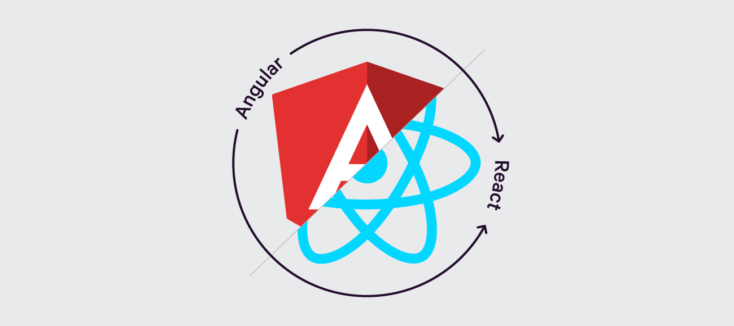
DB UI Frameworks
Component-based architecture: Both Angular and React use a component-based architecture, which allows developers to create reusable UI components and easily manage their state.
Virtual DOM: React uses a virtual DOM, which helps improve performance by reducing the number of updates needed to render the UI. Angular also has a similar feature with its change detection mechanism.
Single Page Applications (SPAs): Both Angular and React are well-suited for building SPAs, which provide a seamless user experience by dynamically updating the content without reloading the entire page.

Slide 8
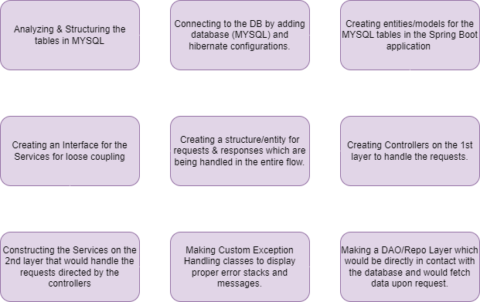

Creating Angular UI & Spring Boot Backend For APP Auto Postage
Backend Services
The controller service Dao model
JDBC(Java database Connectivity Theory)
Multiple Table Mapping
Spring Annotations
Custom Exception Handling
JWT Token
Configure Http Requests

Slide 9

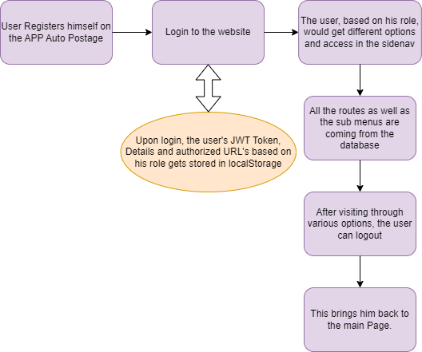
Frontend:
Creating an angular Project
Creating and designing Components:
Login & Register Page
Toggling Side-nav & Navbar
Dashboard
Various Forms & Tables linked with Sub-Menus
Developing a Global Service File on Angular
Making use of Local Storage for various purposes.
Handling Routes & Sub Menus from the Backend based on User Role.
Using various directives in order to bind and maintain the flow of data.

Slide 10
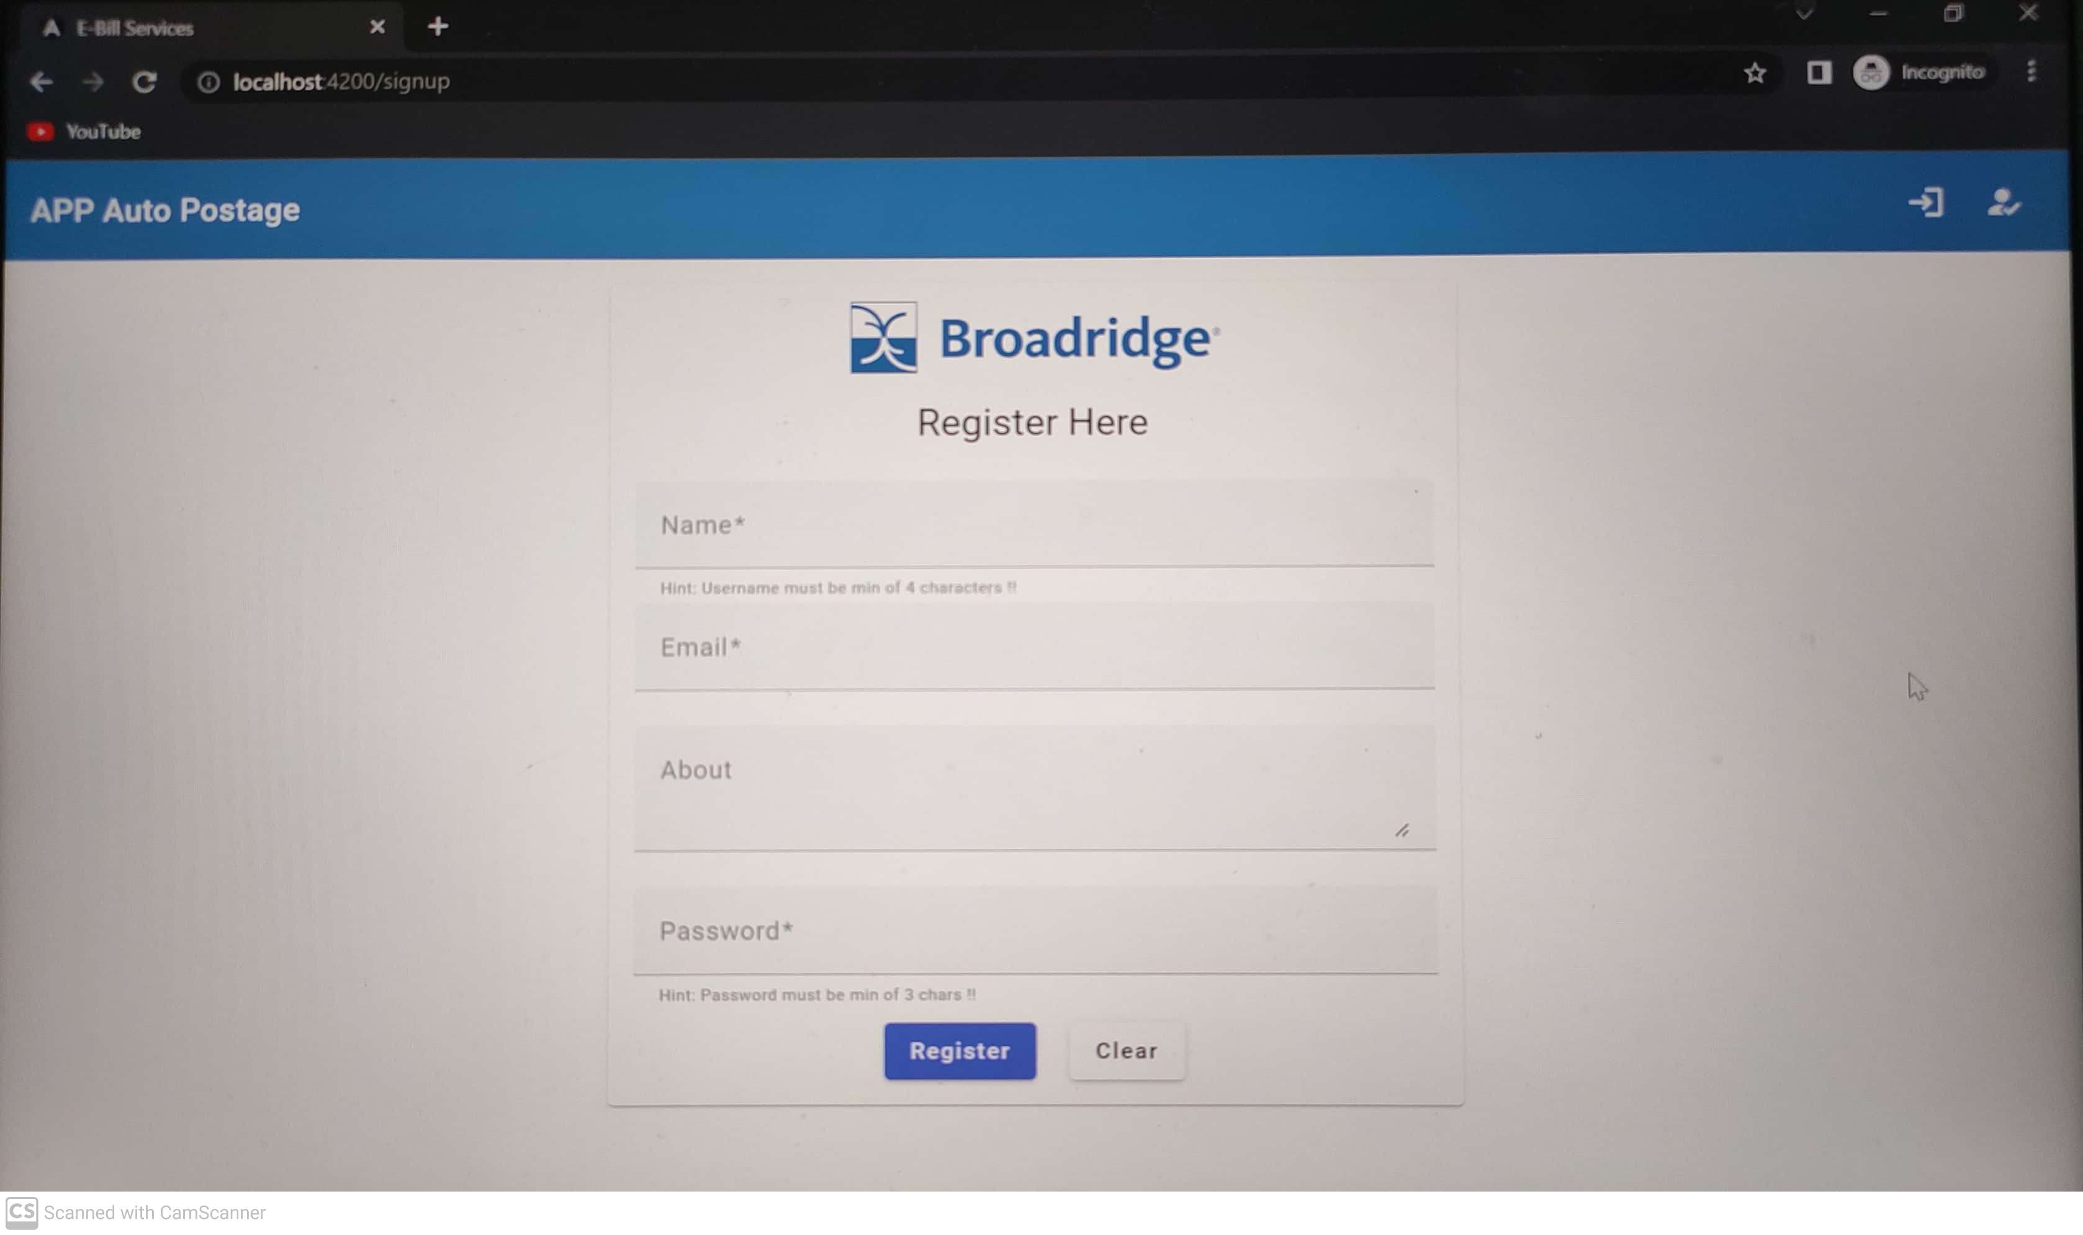
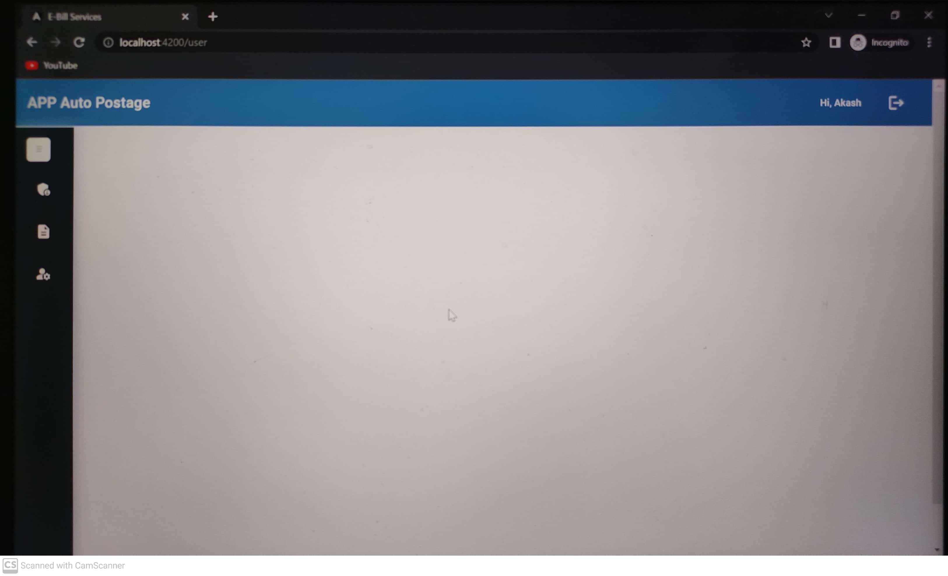
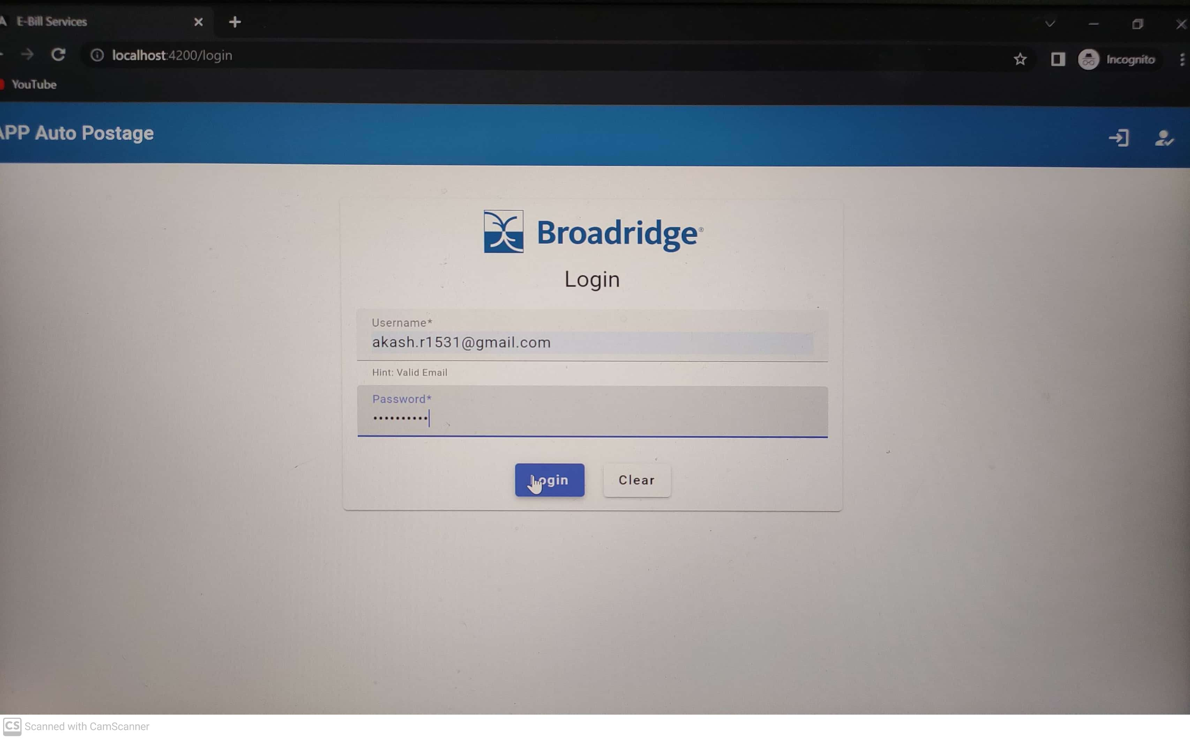

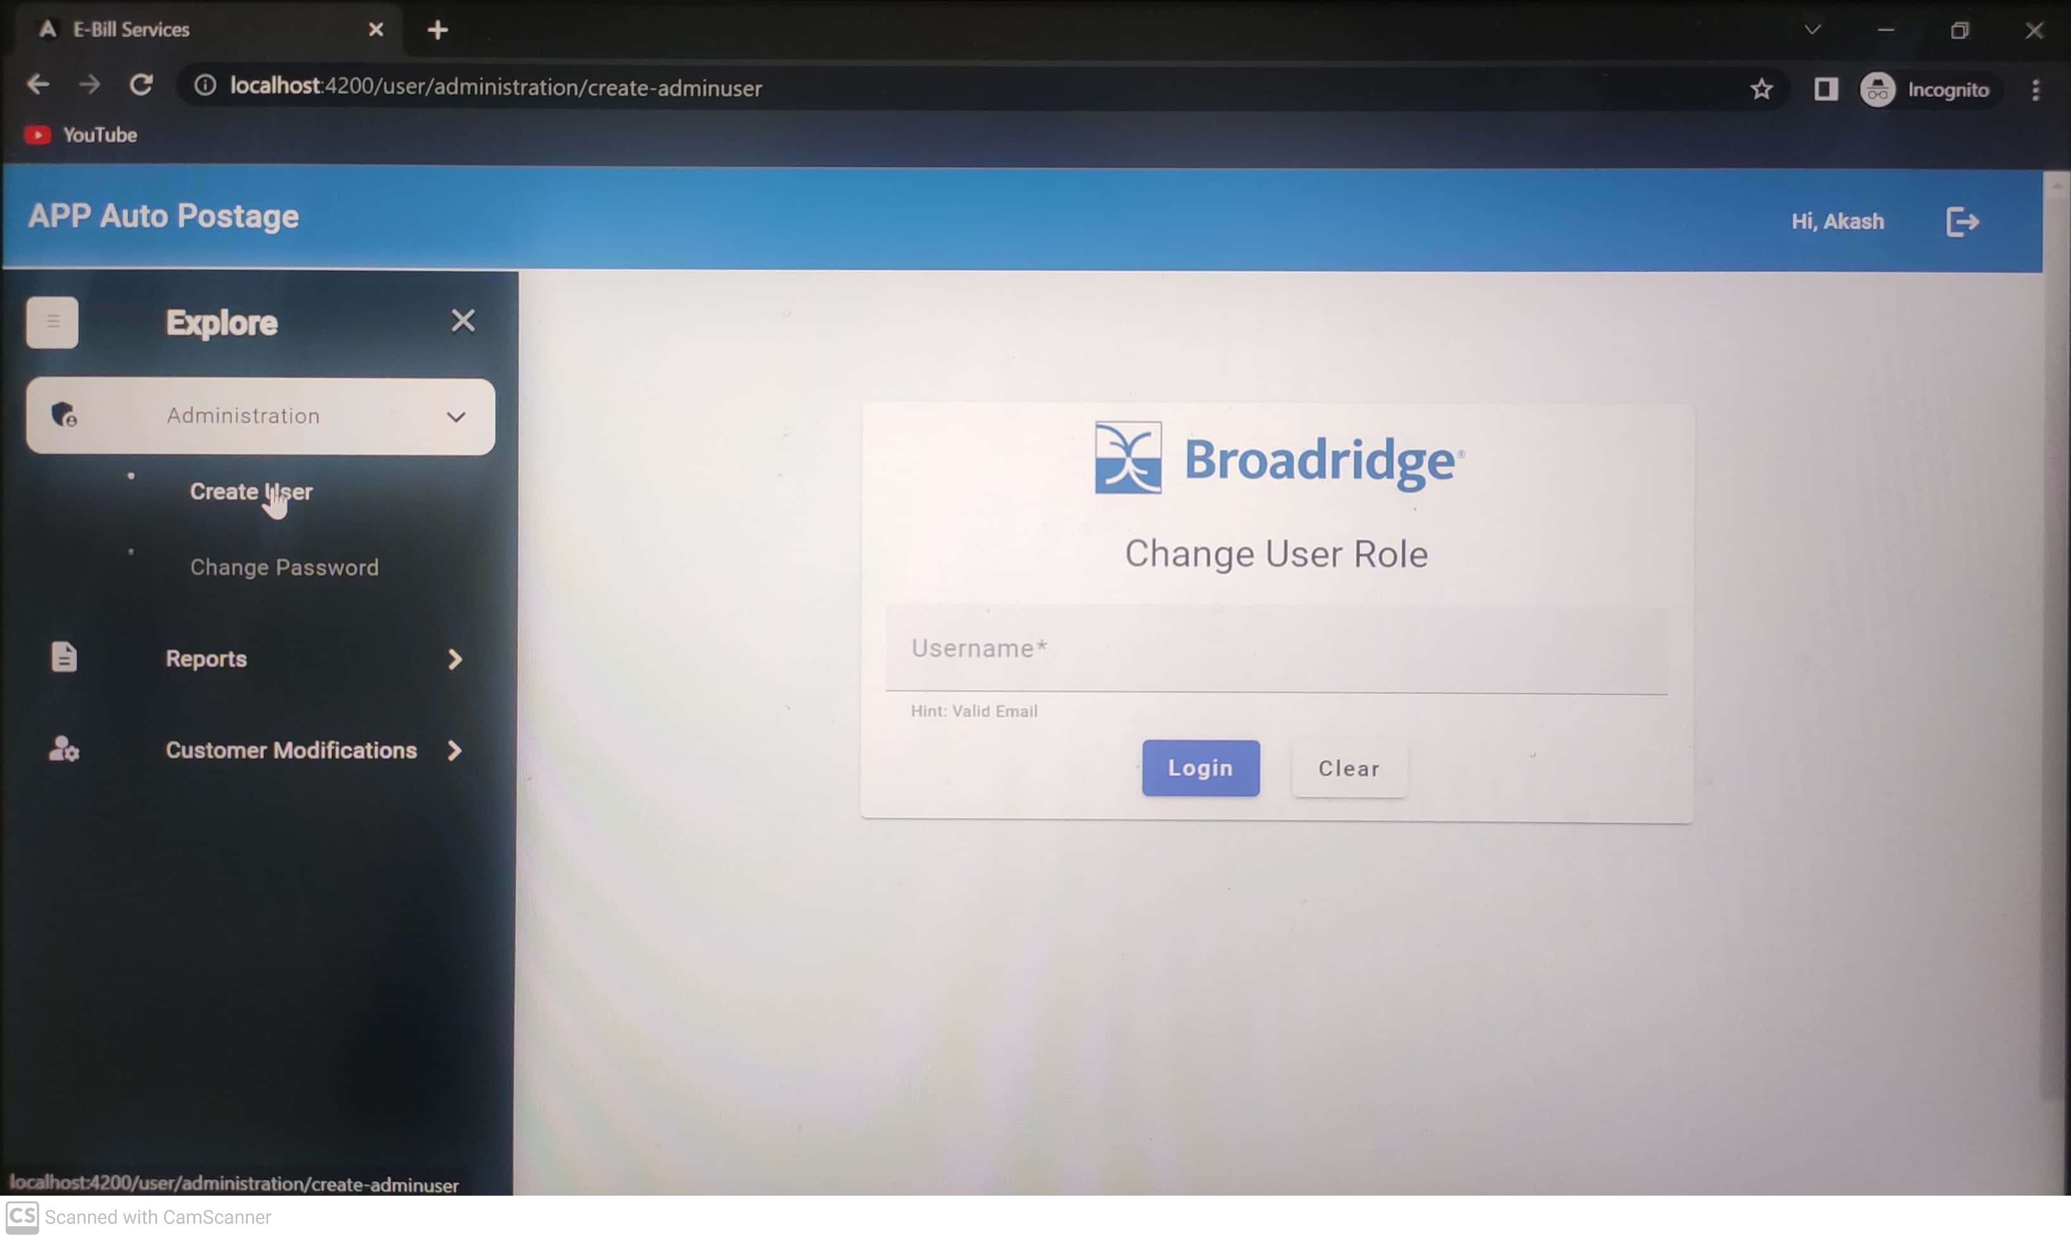
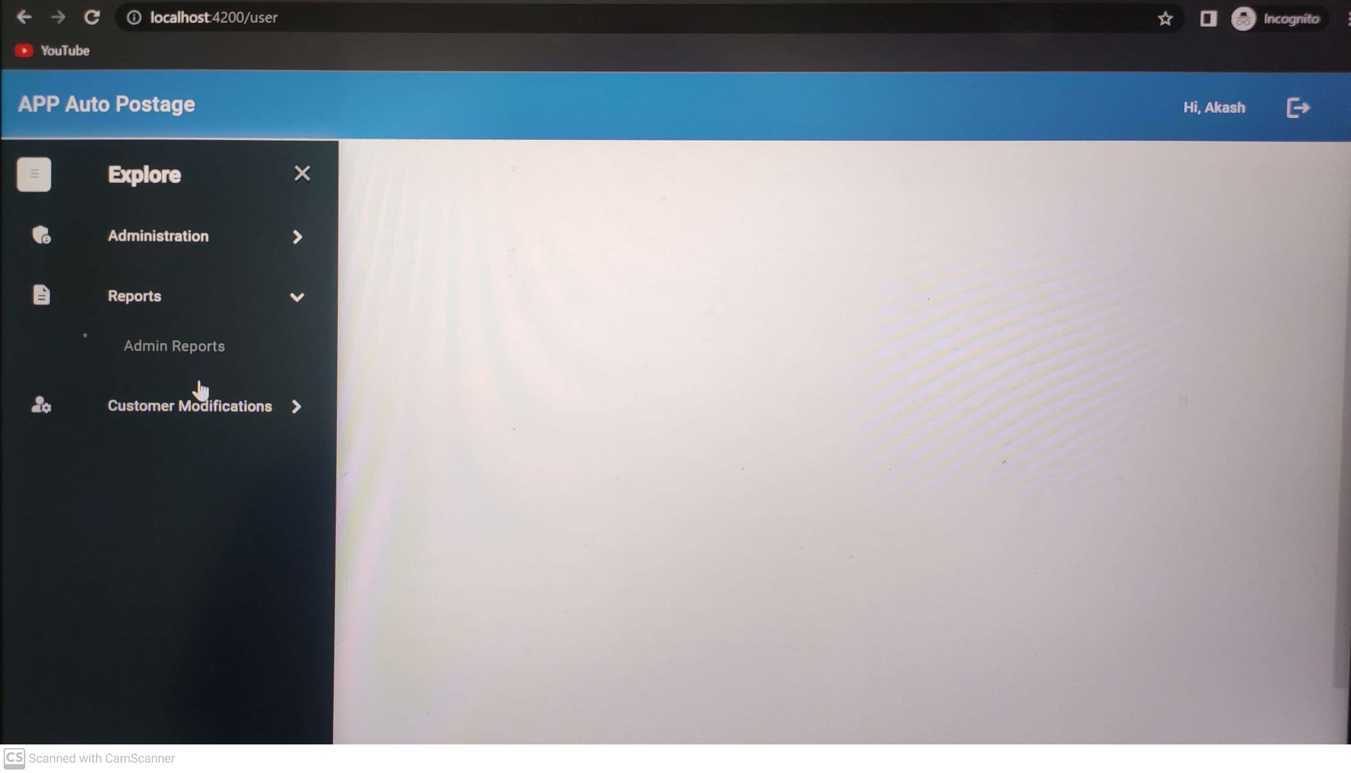
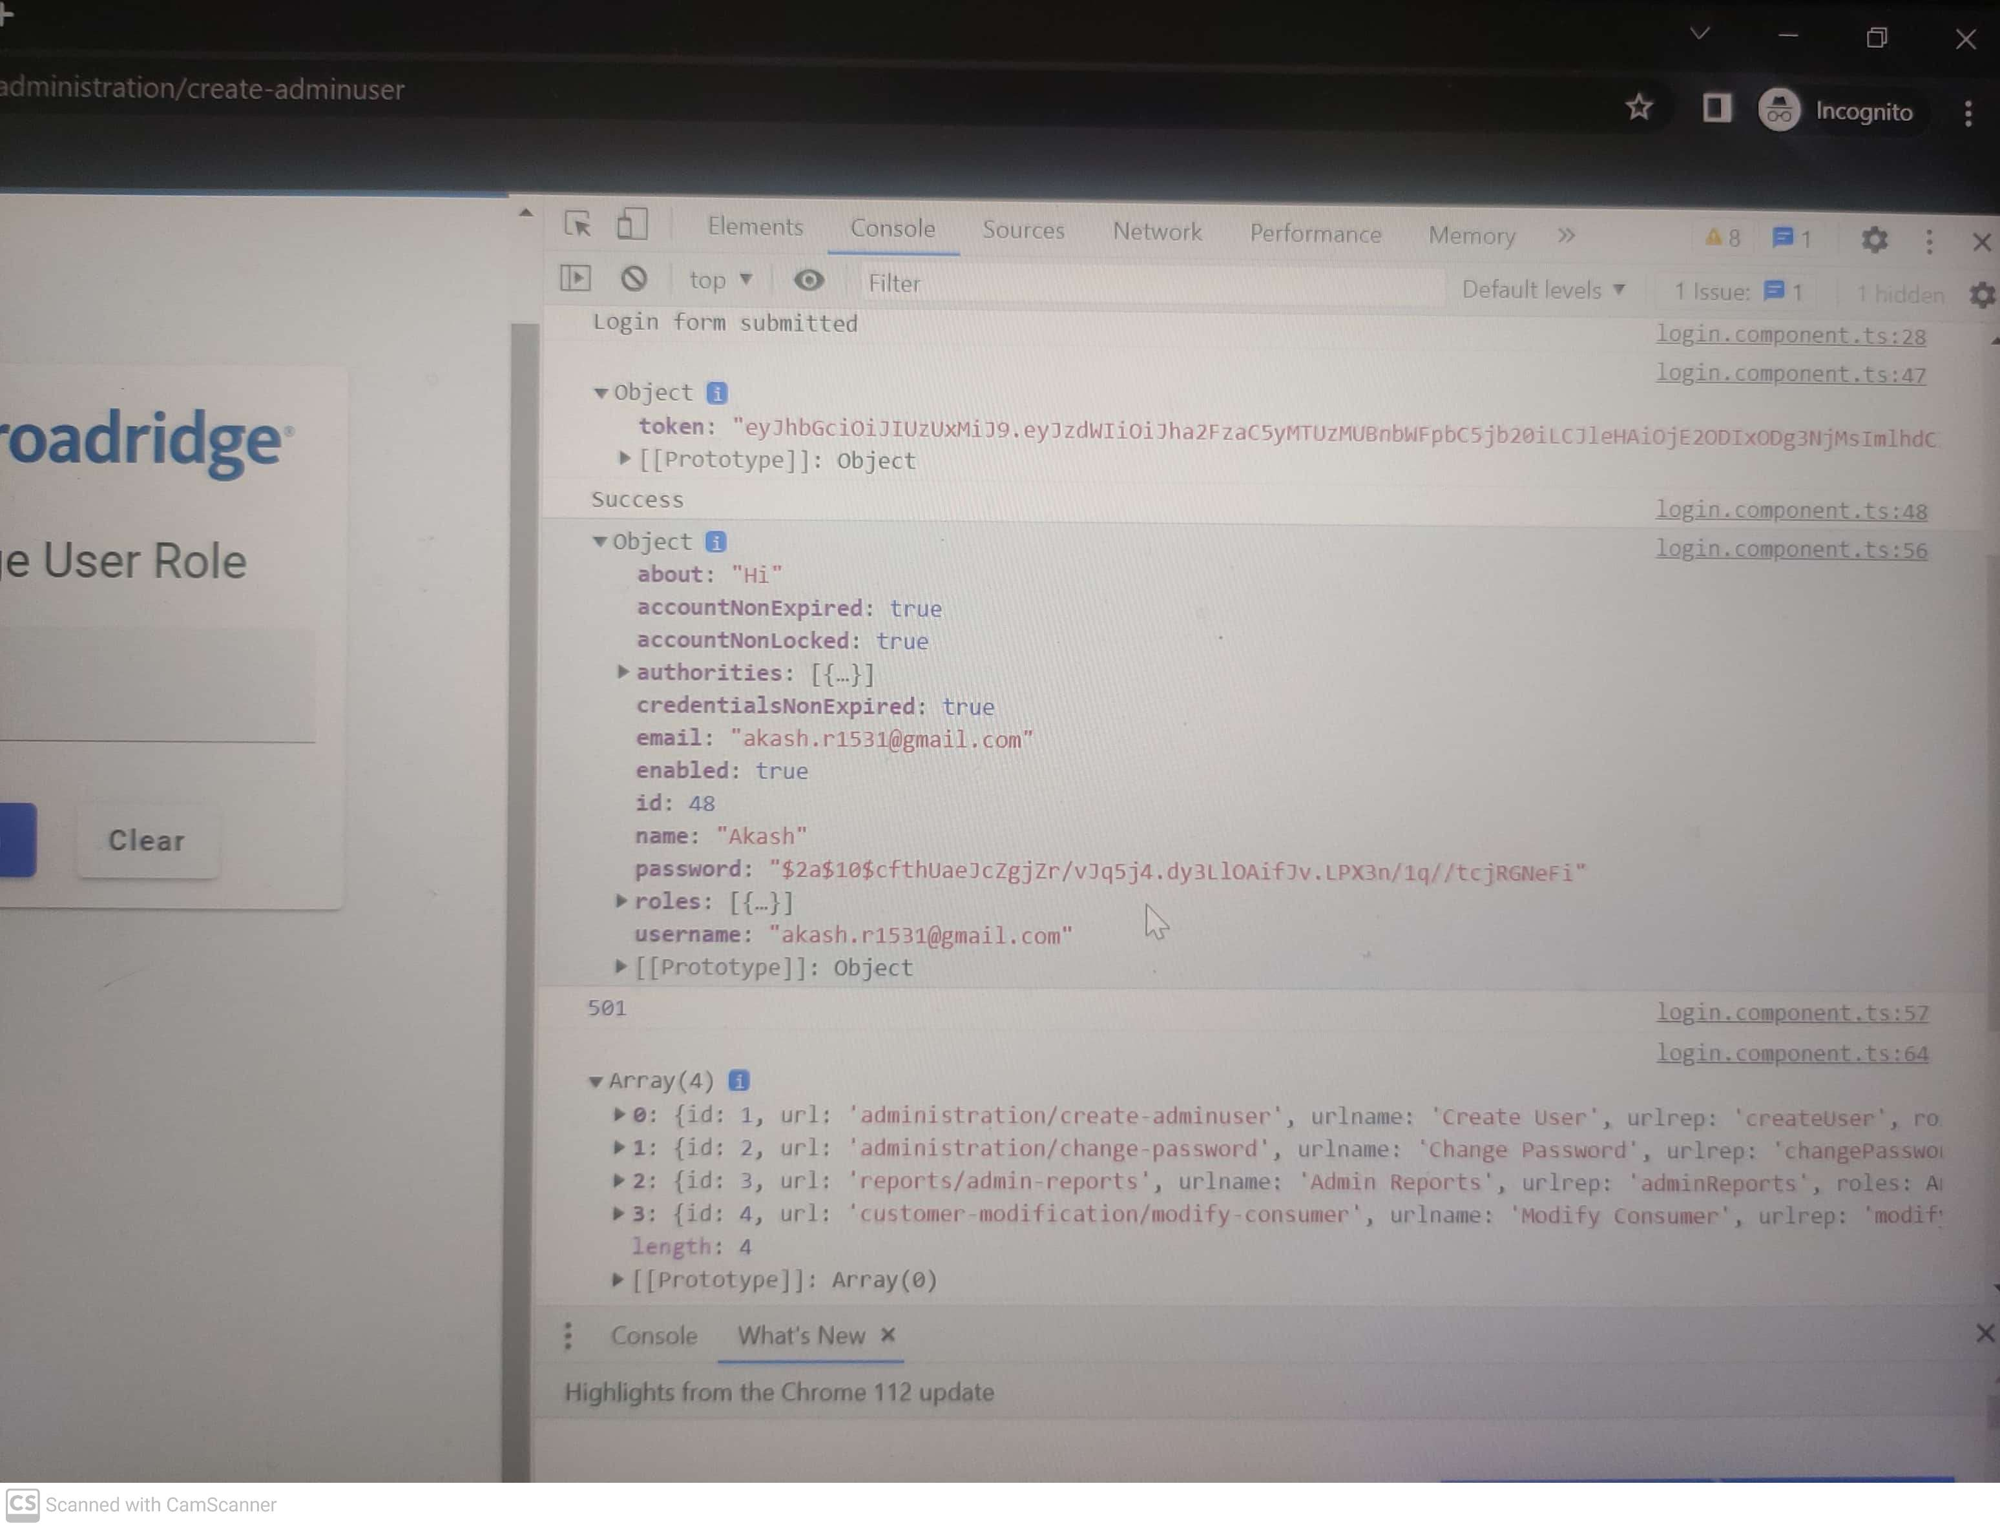

Results

Slide 11
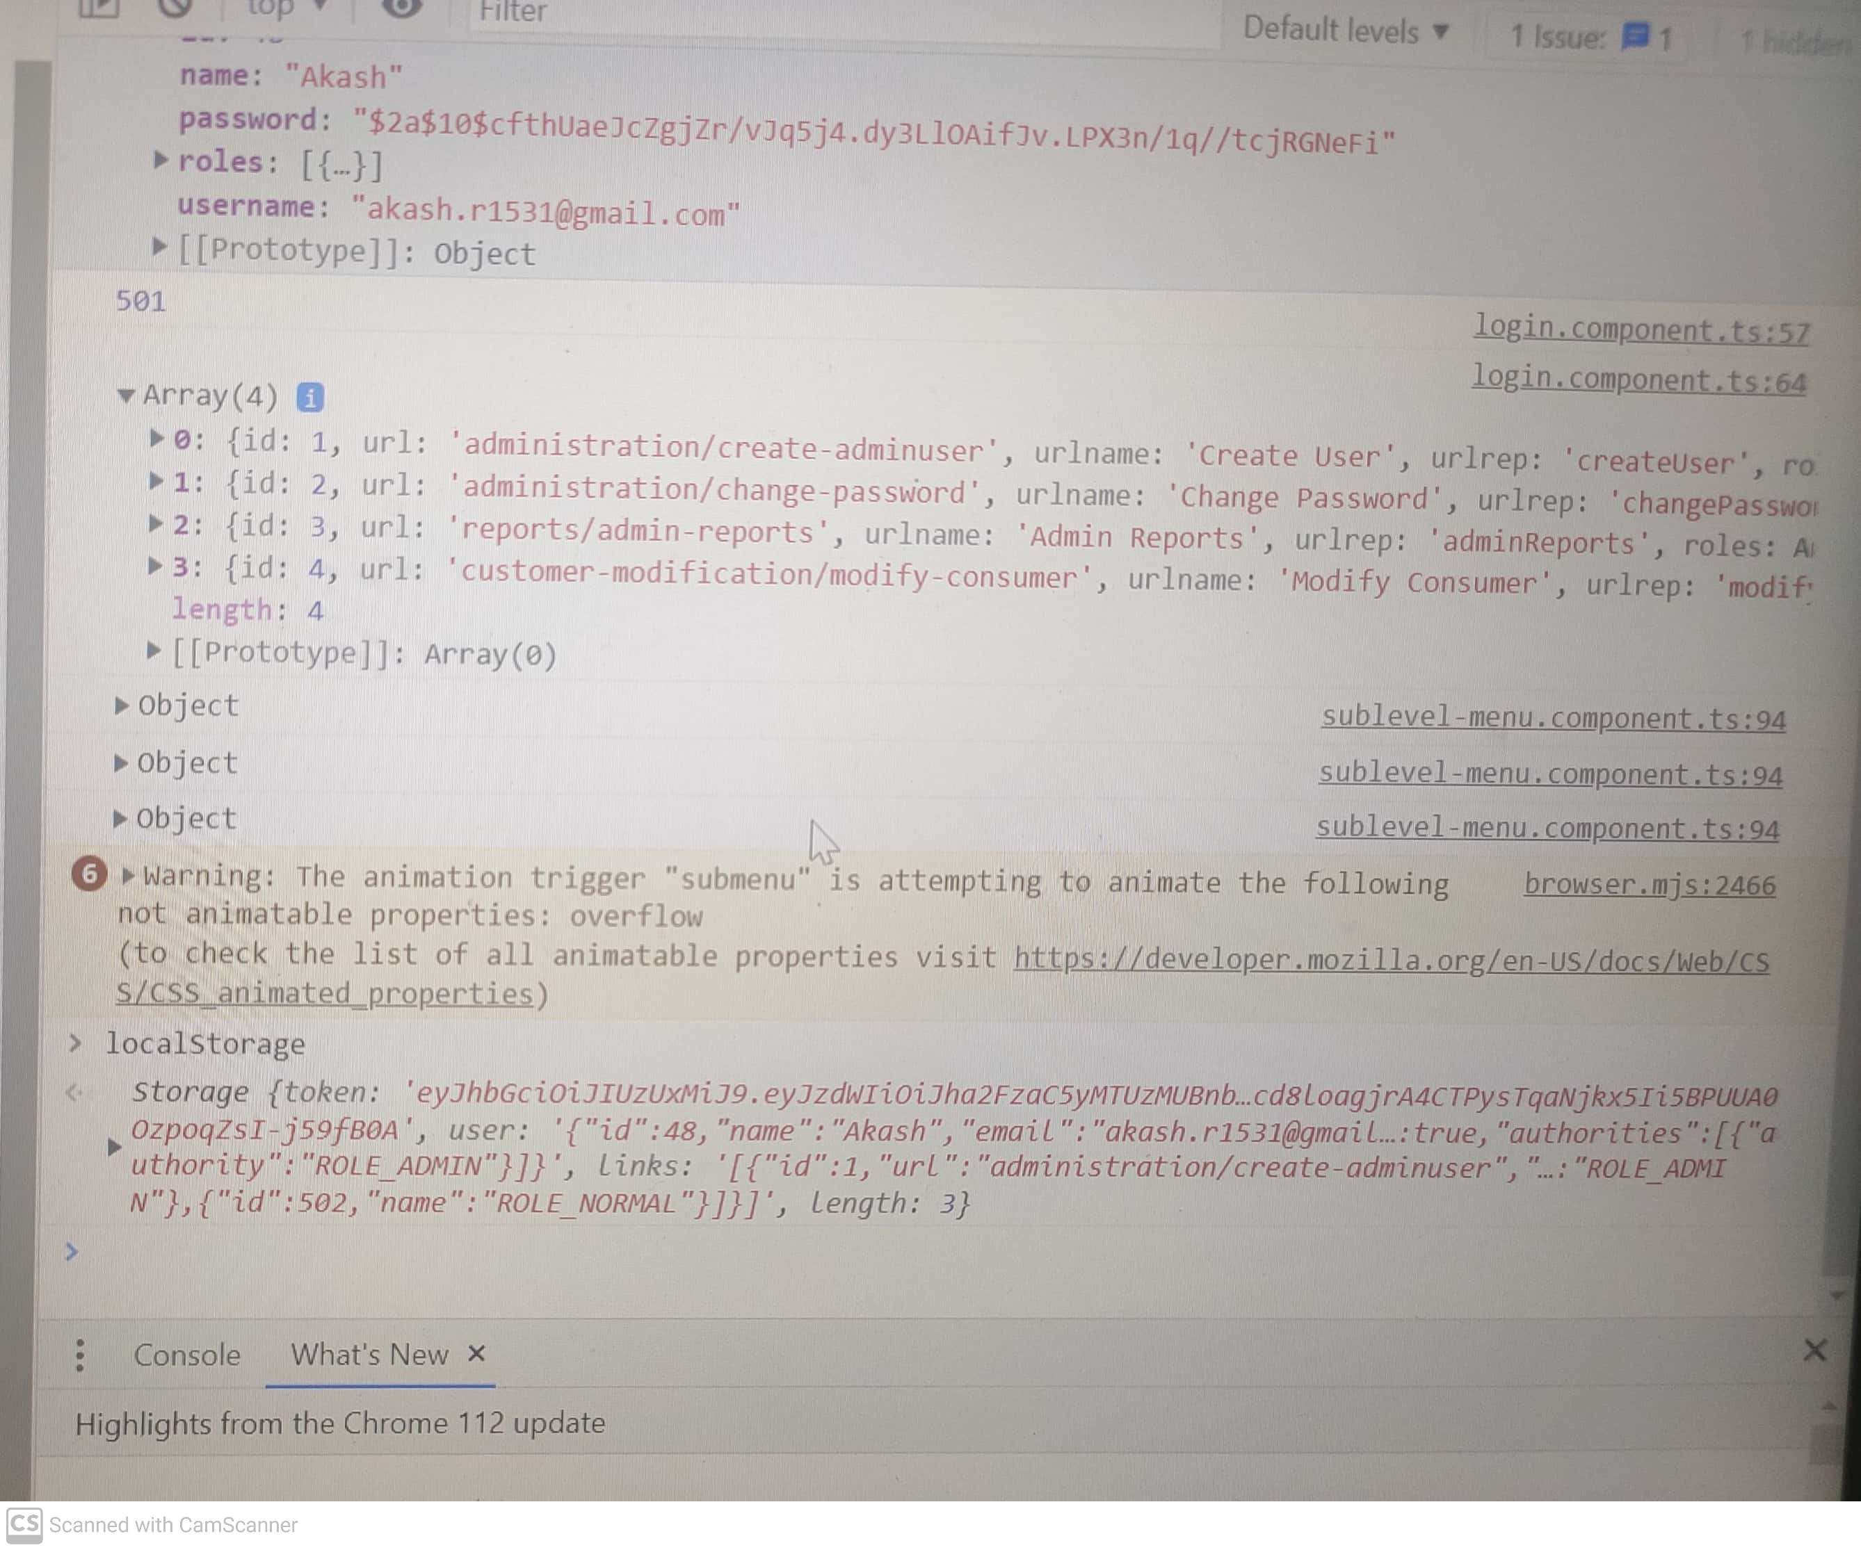
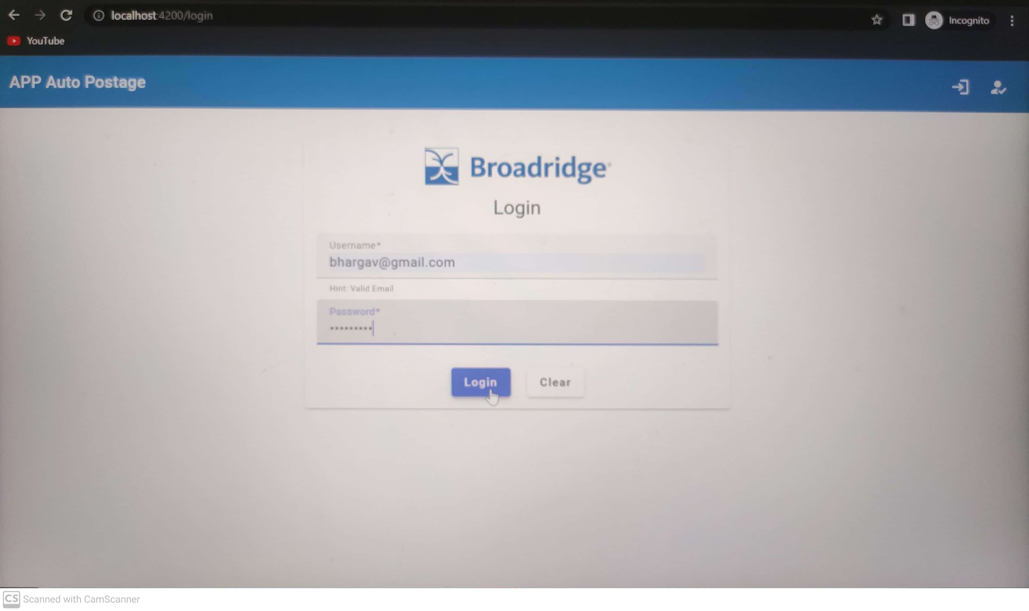
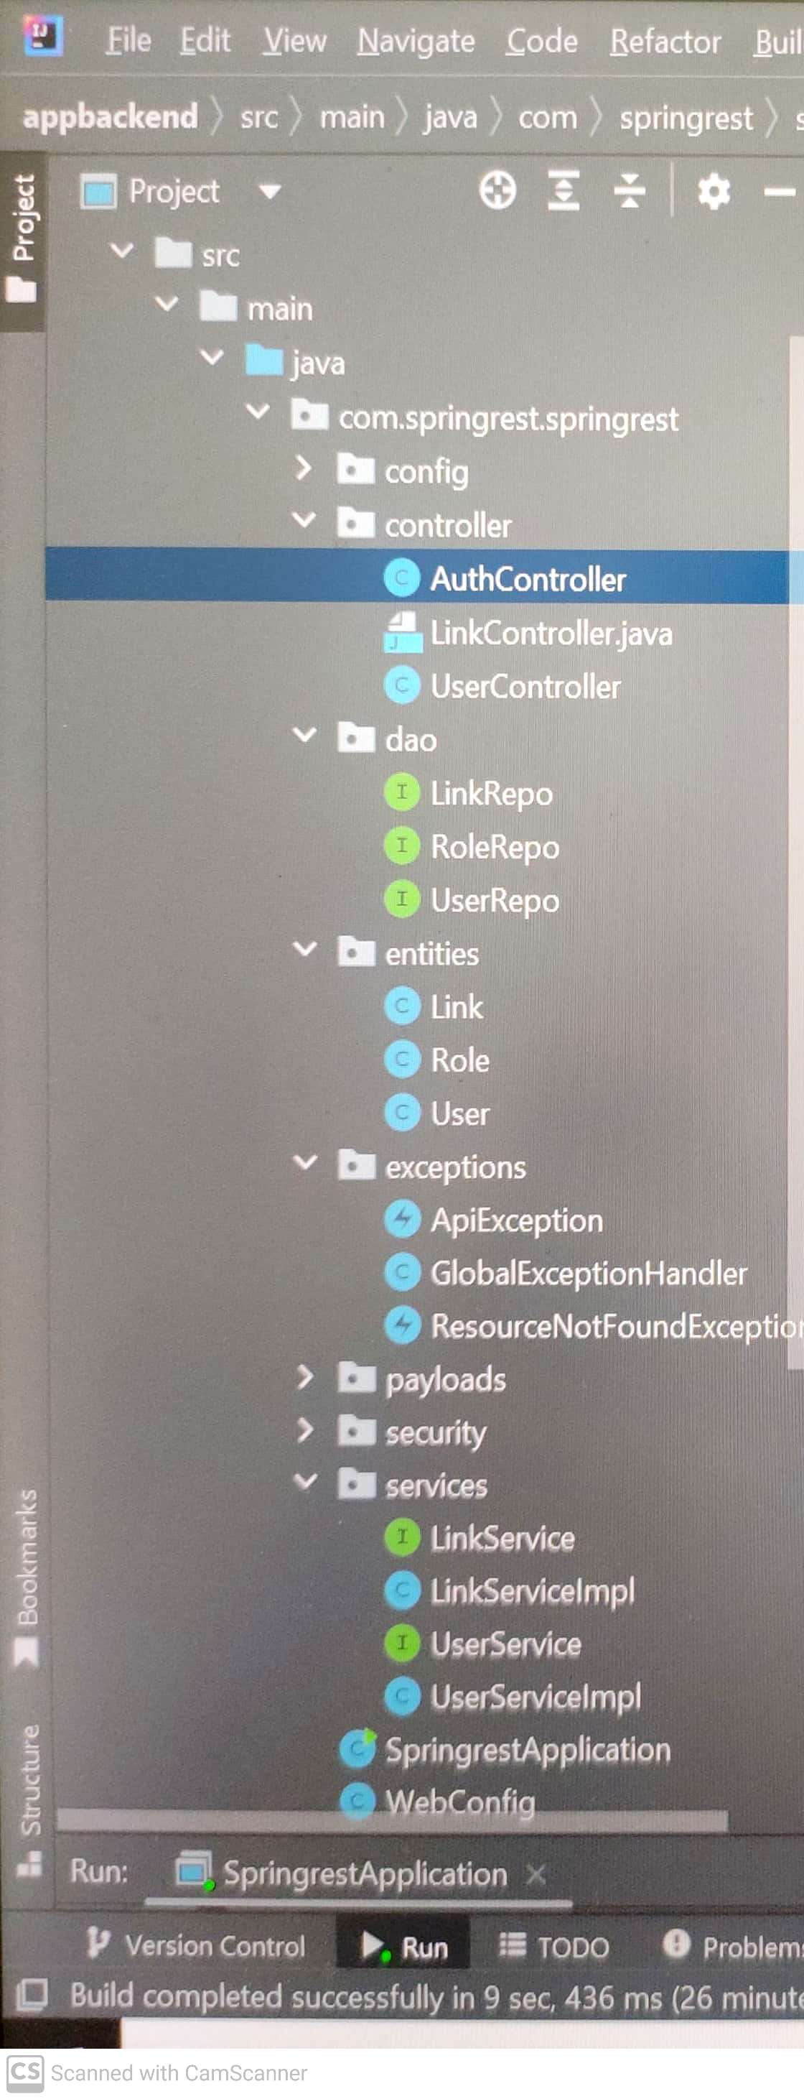
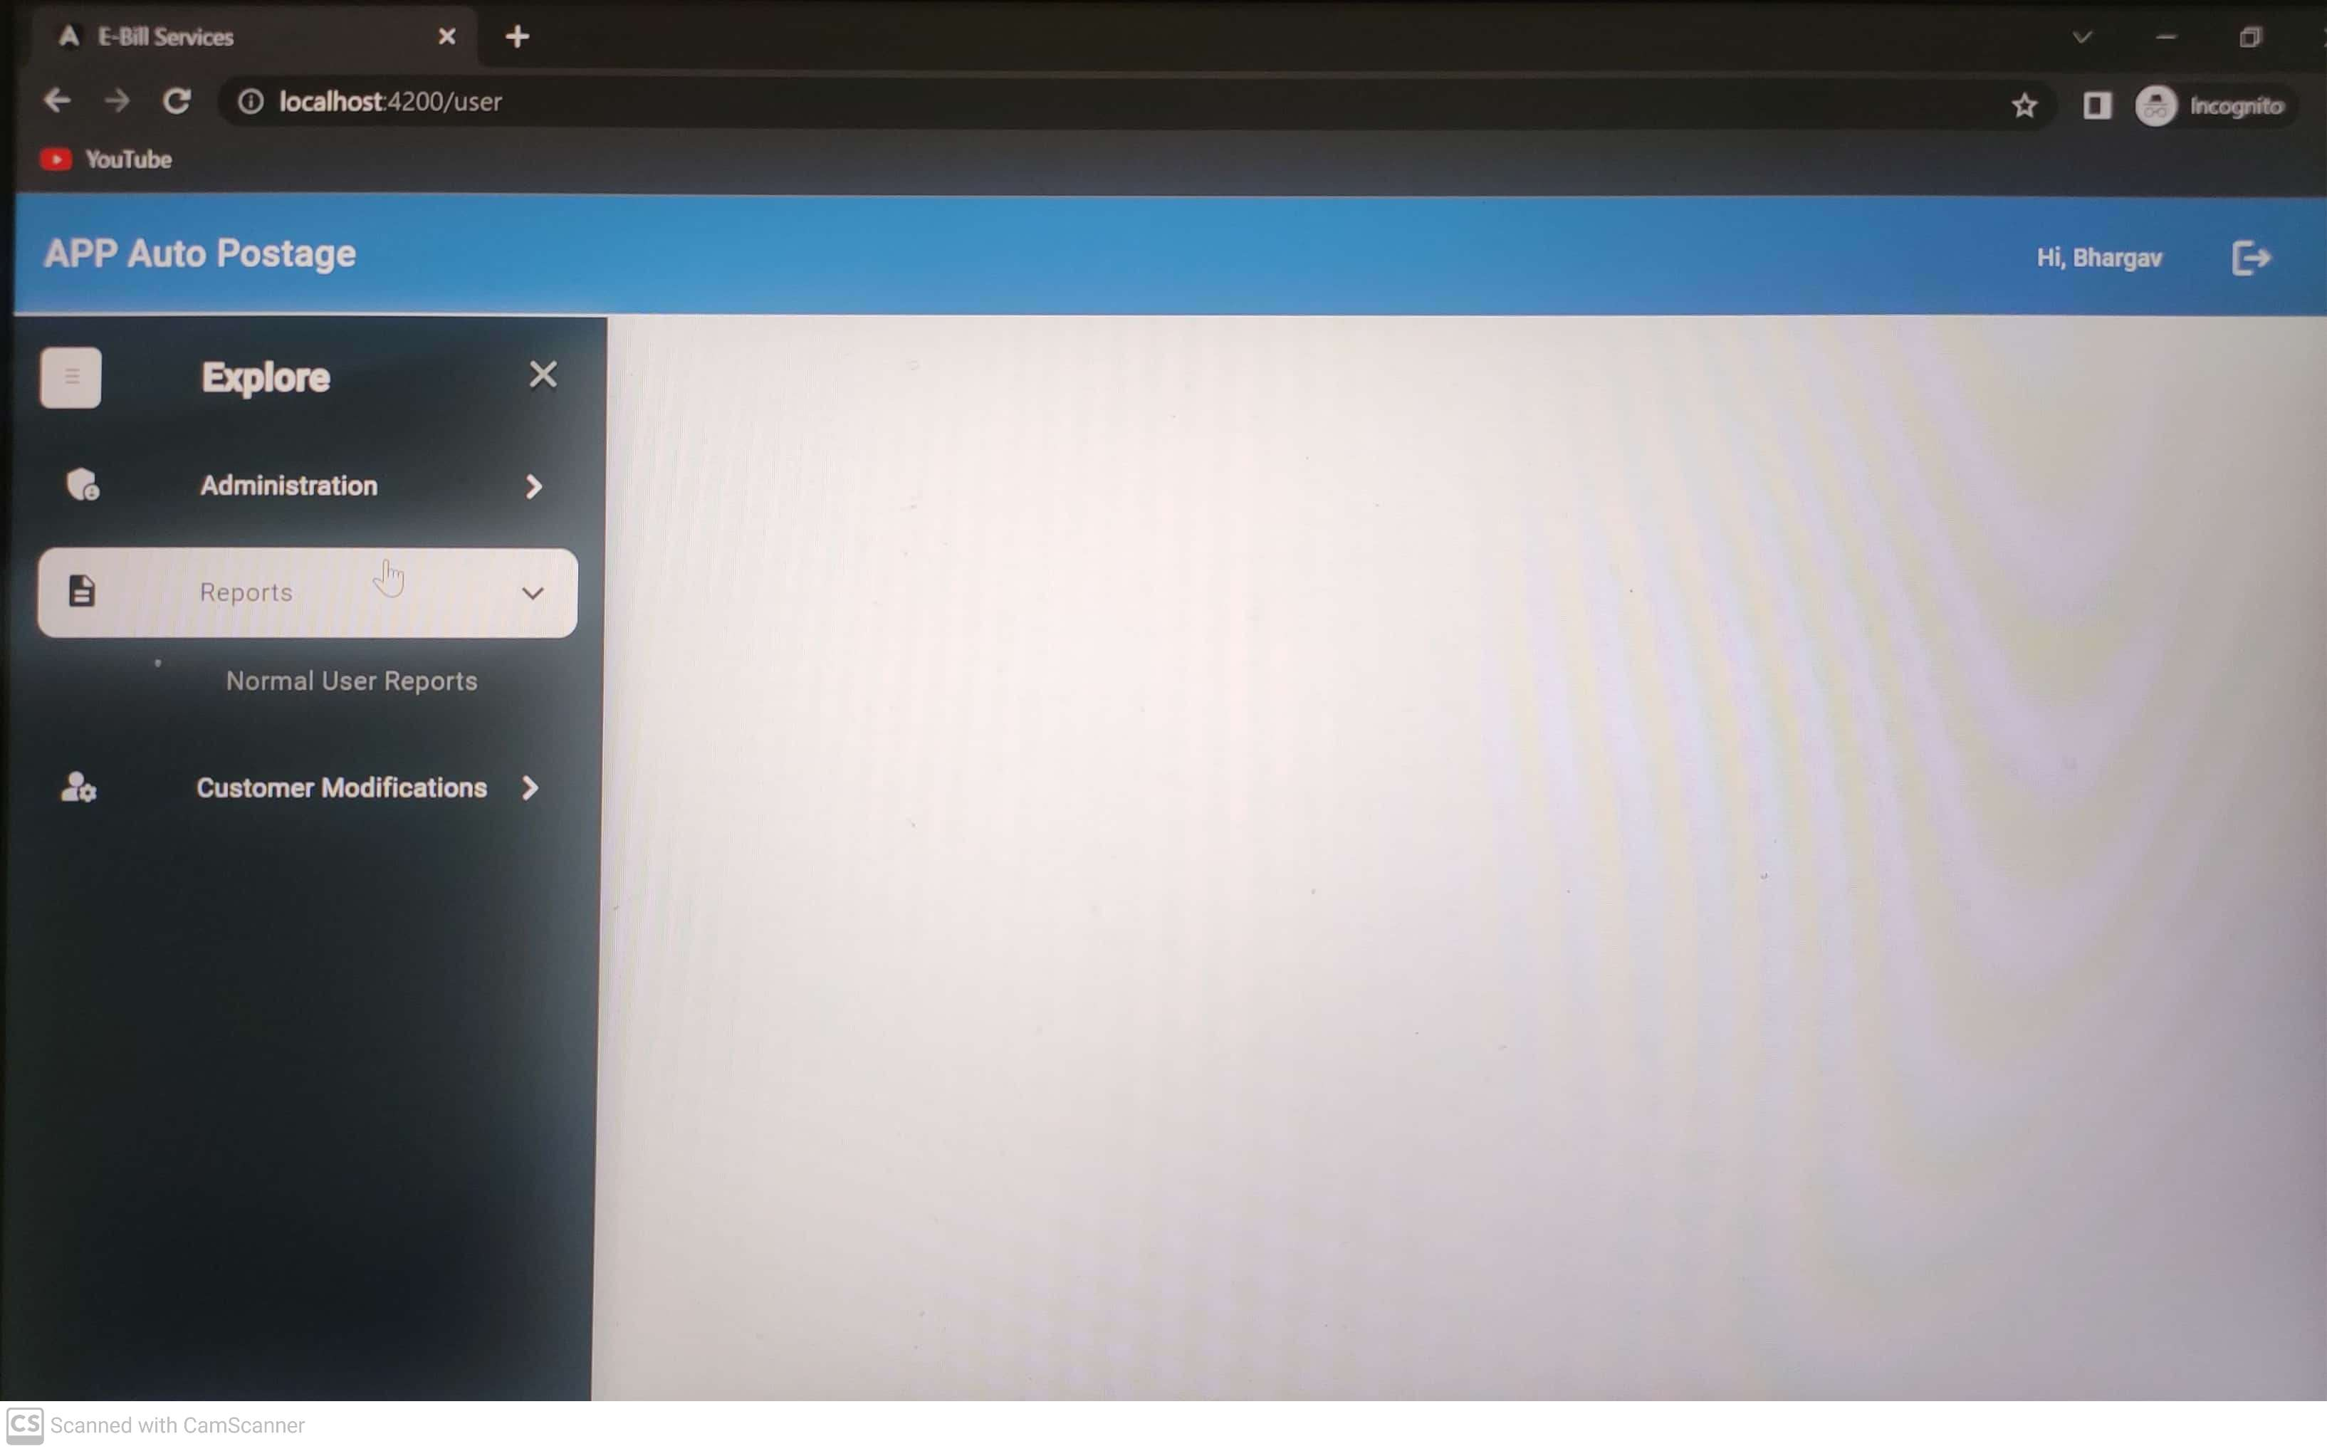
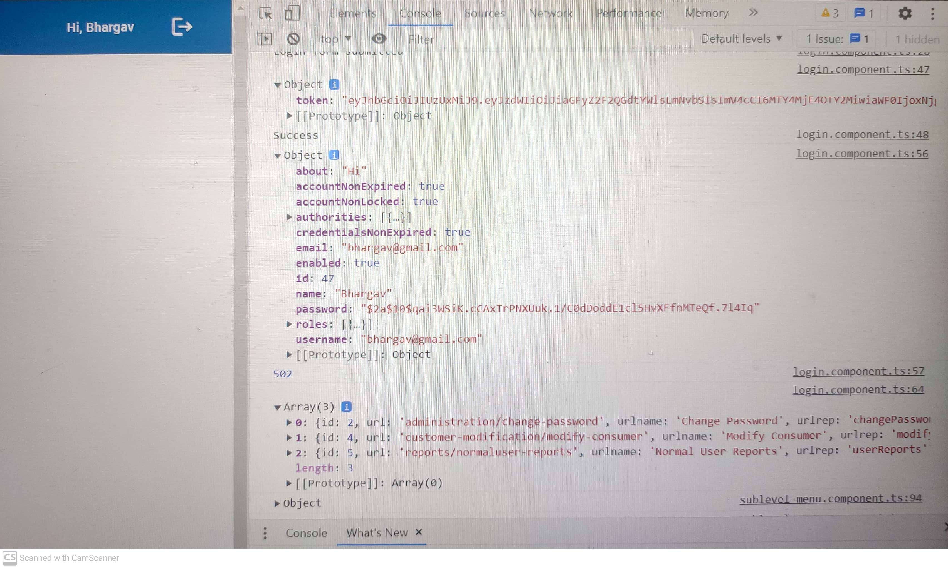
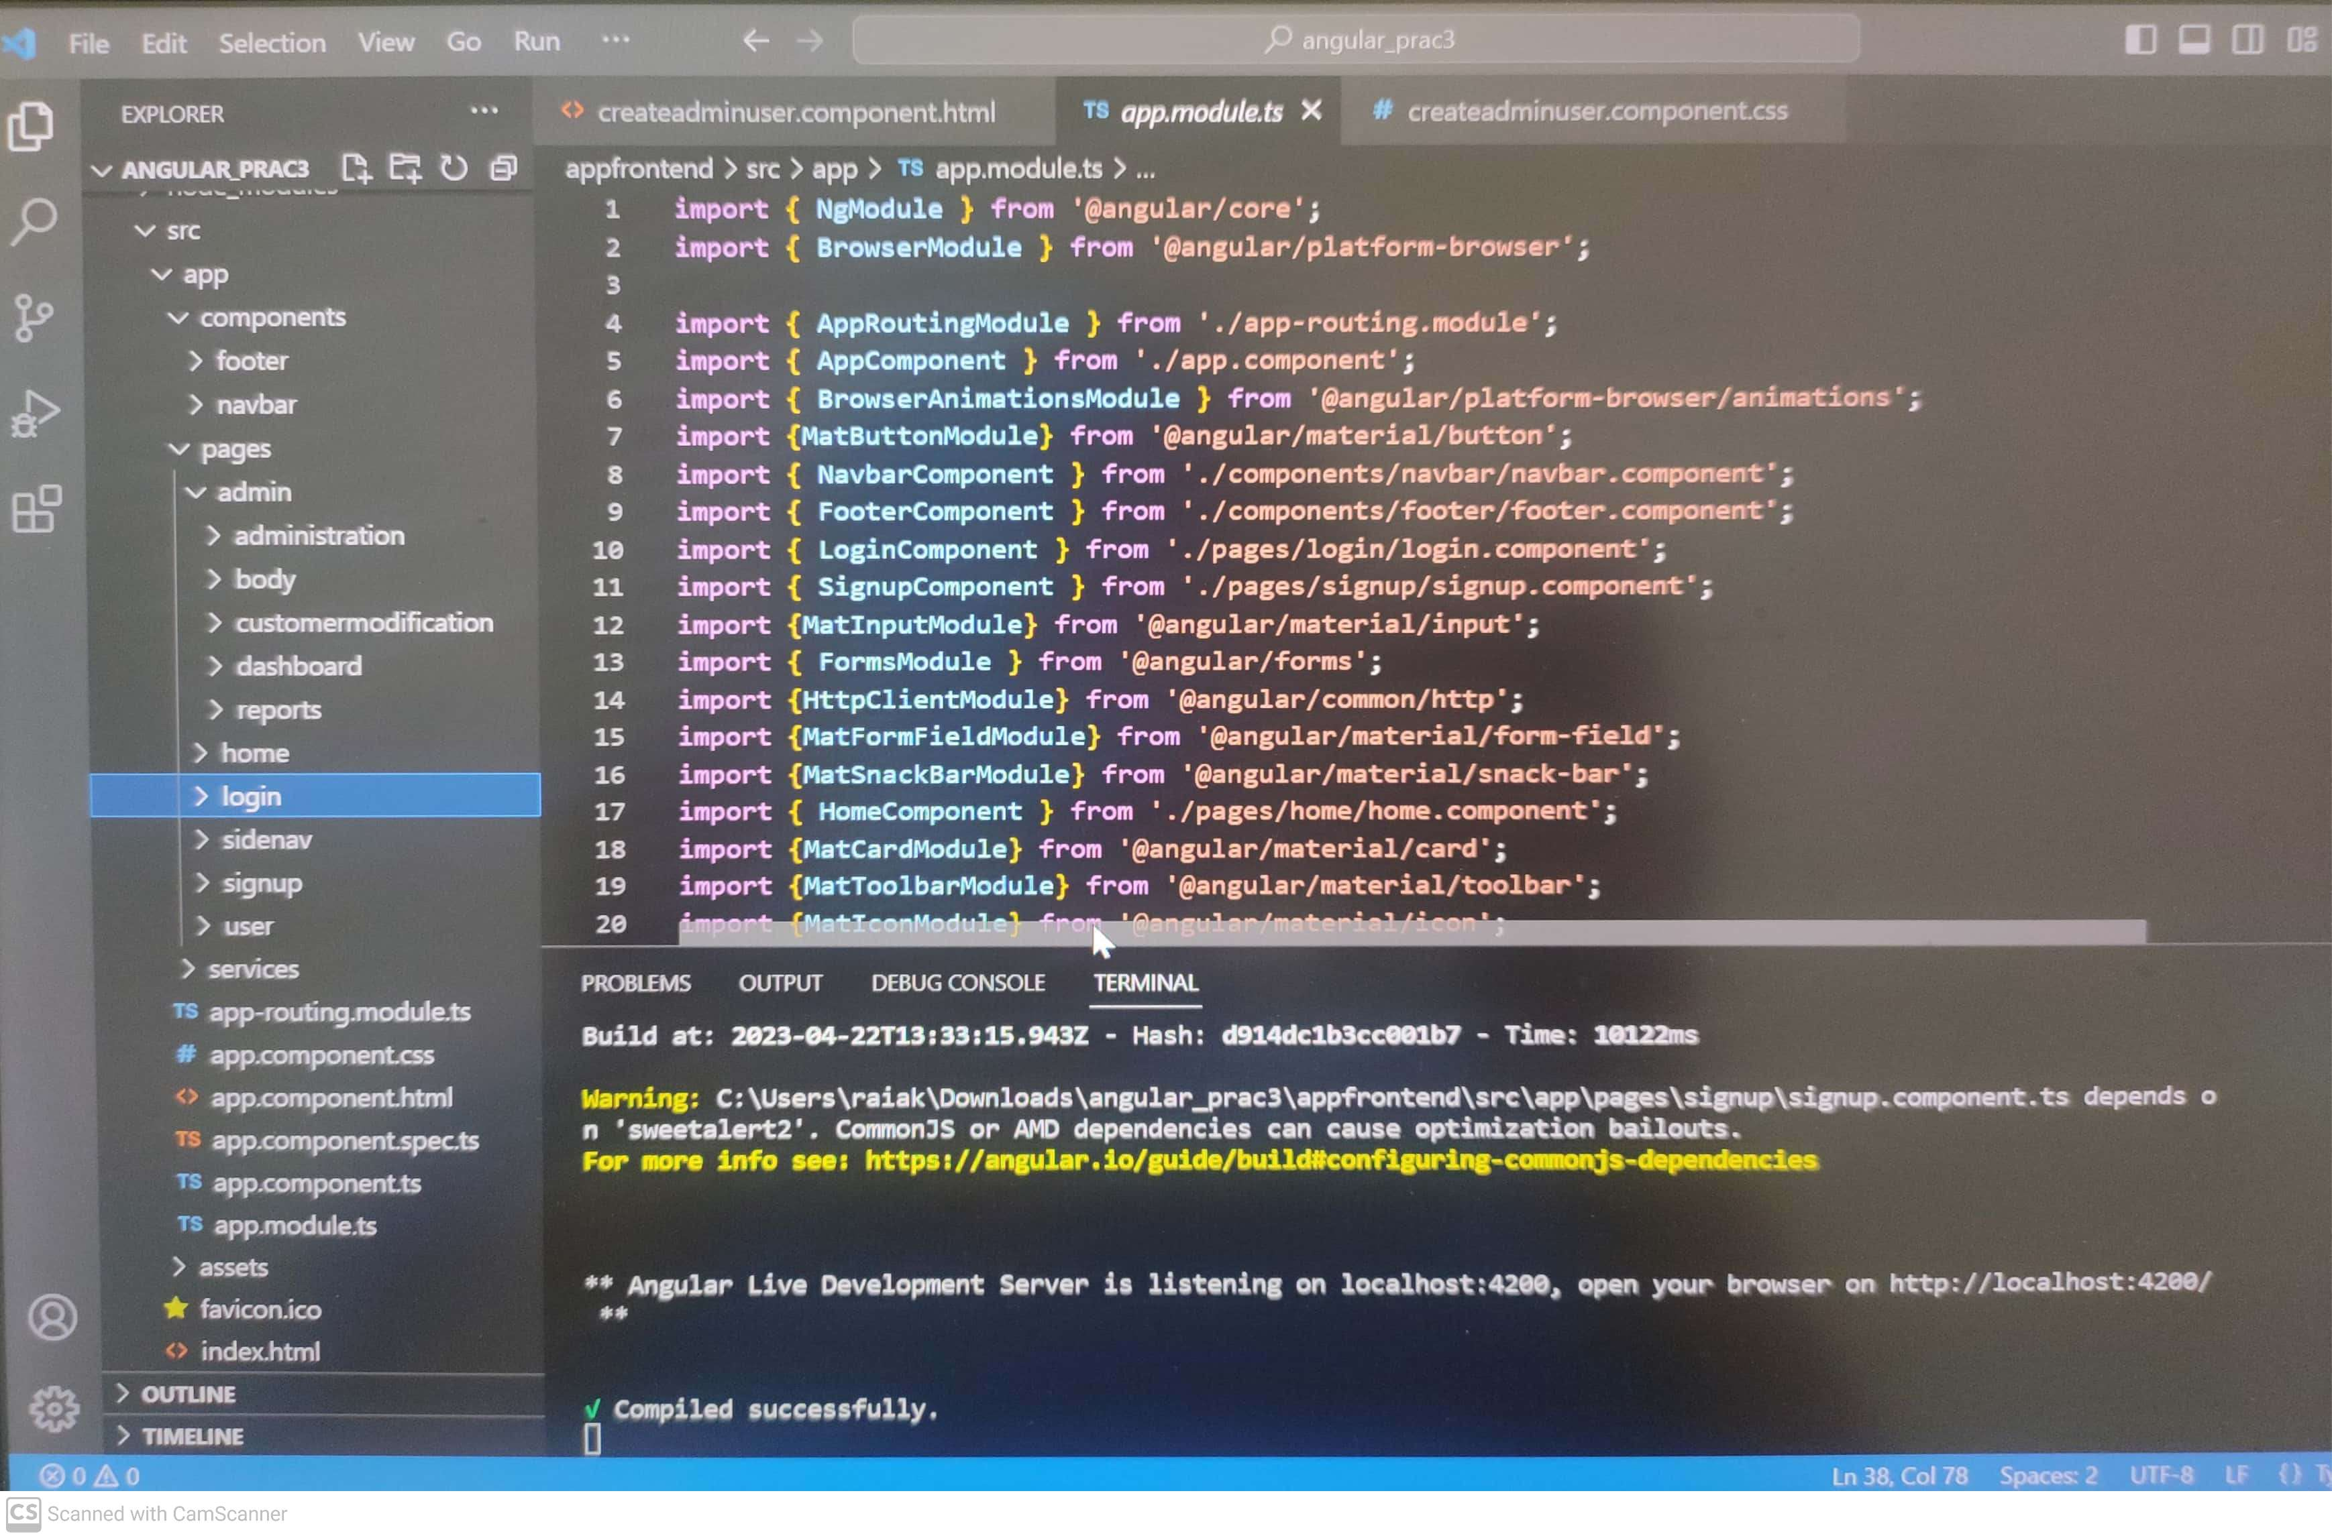

Slide 12
Creating application for Migration & Encryption of Data for E-Bill Client
Connecting to database using JDBC(Java Database Connectivity)
Maintaining Singleton Design Pattern during connecting to DB.
After establishing the connection, SQL query is executed and data is stored in result Set.
Passed to ResultToCsv function which writes /prints data into CSV File.
Created the pre required Public Key, Private Key and Passphrase for Encryption purposes.
Created functions for Encryption
Finally, stored the encrypted data into a PGP format file.

Slide 13
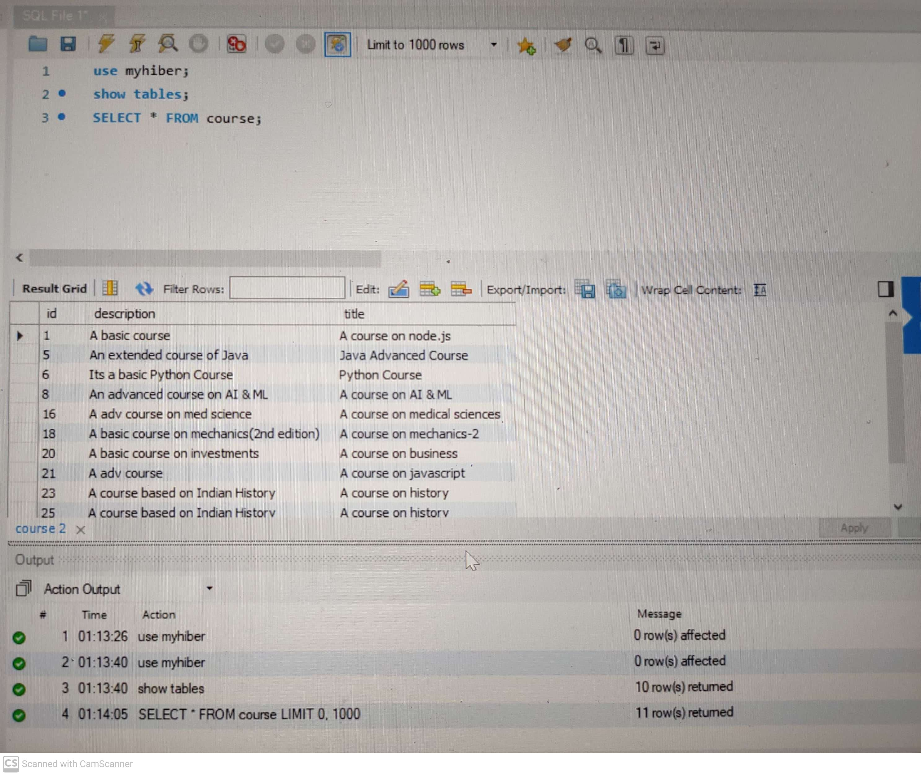
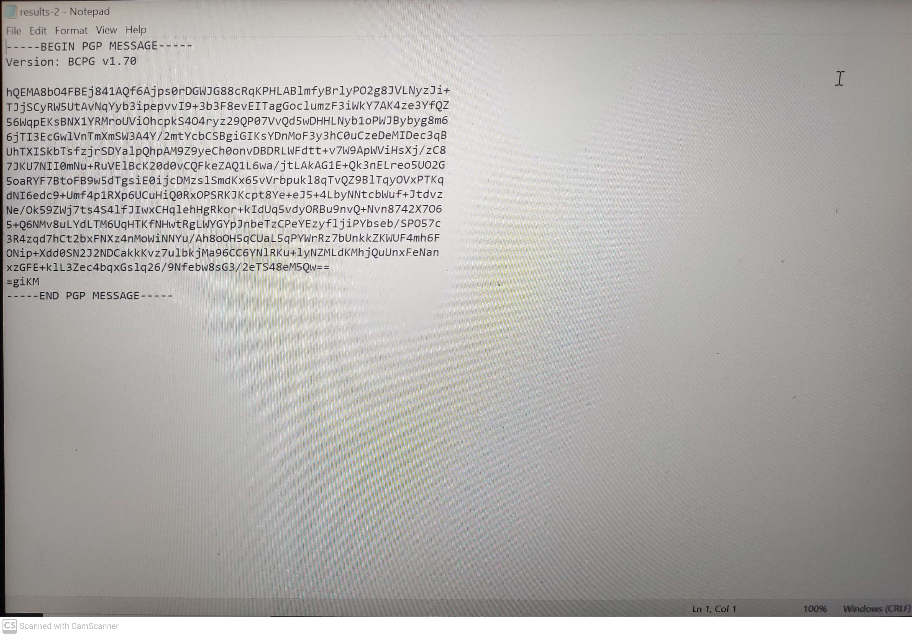
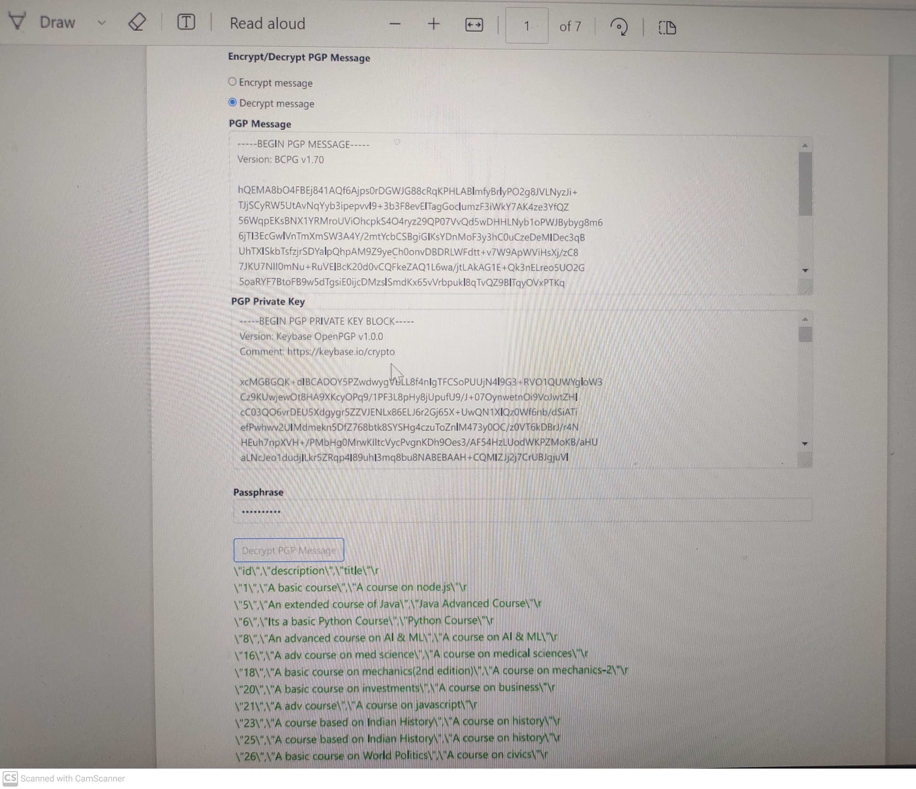
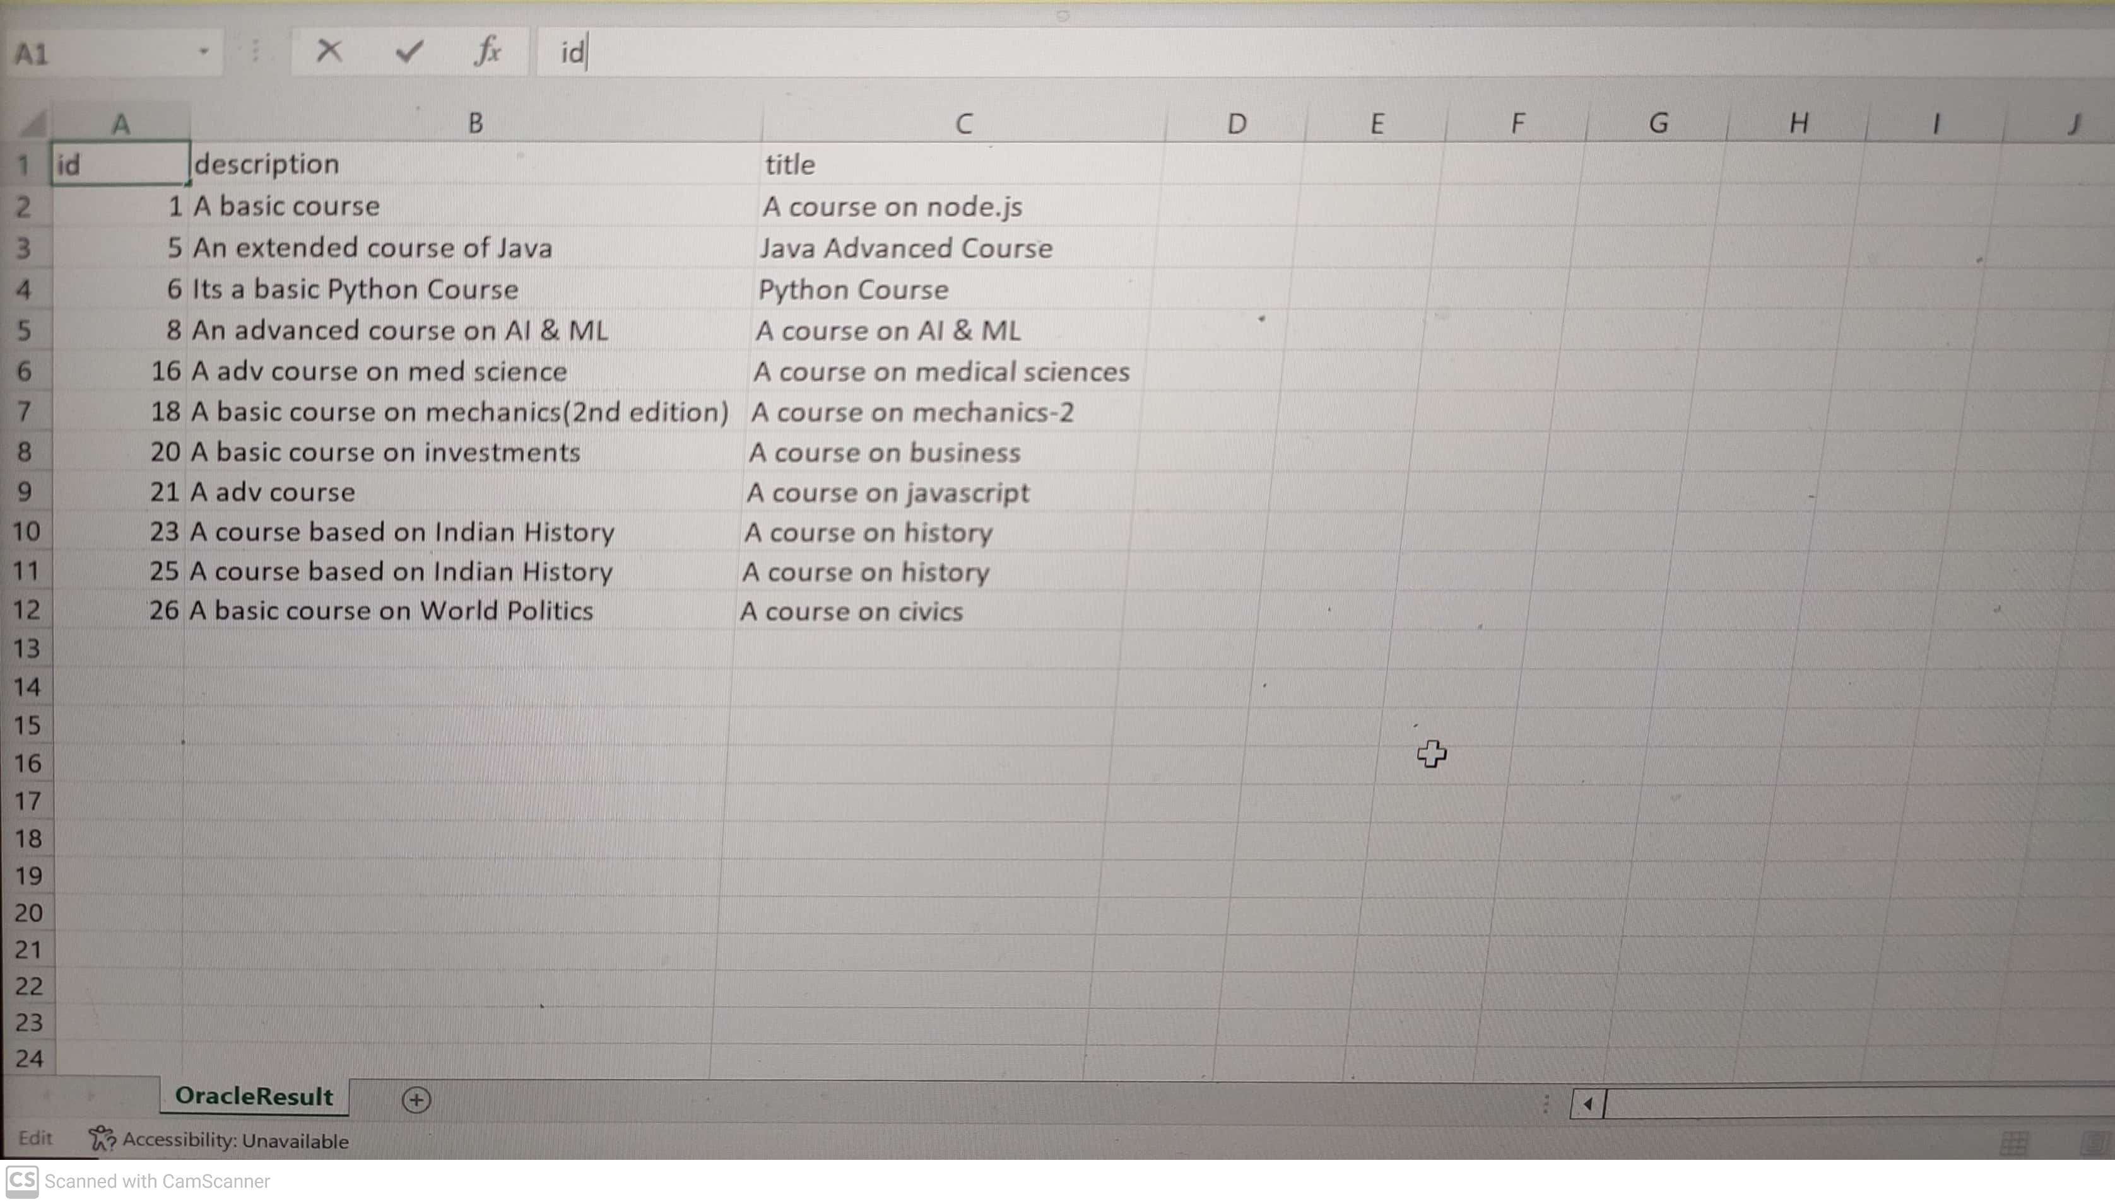
Results

Slide 14
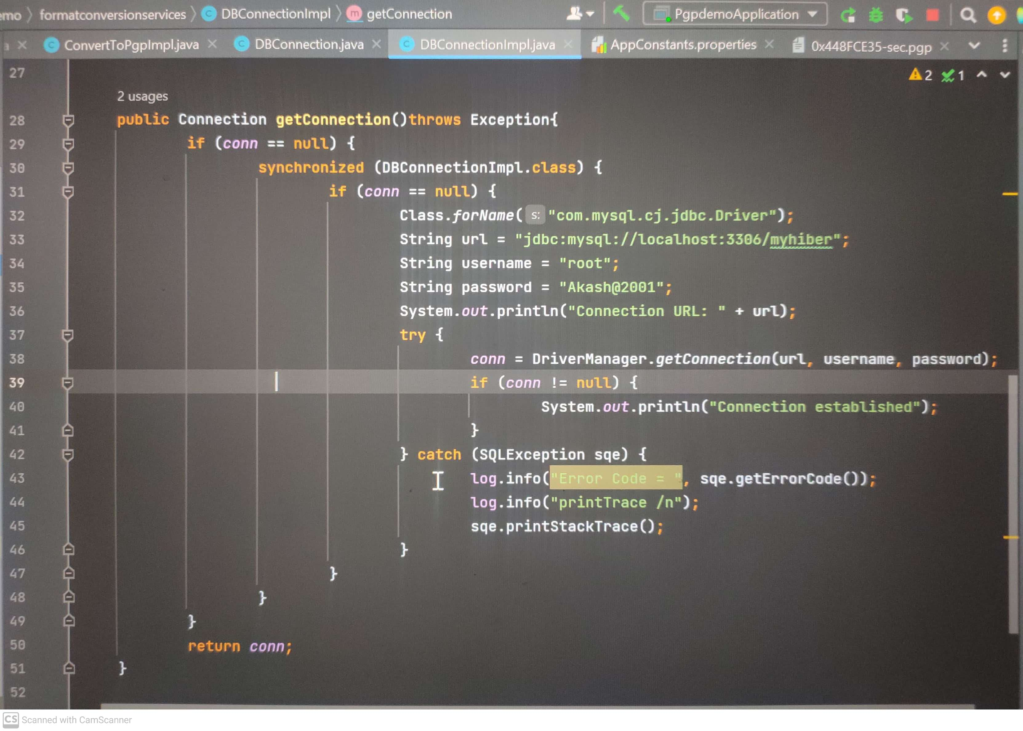
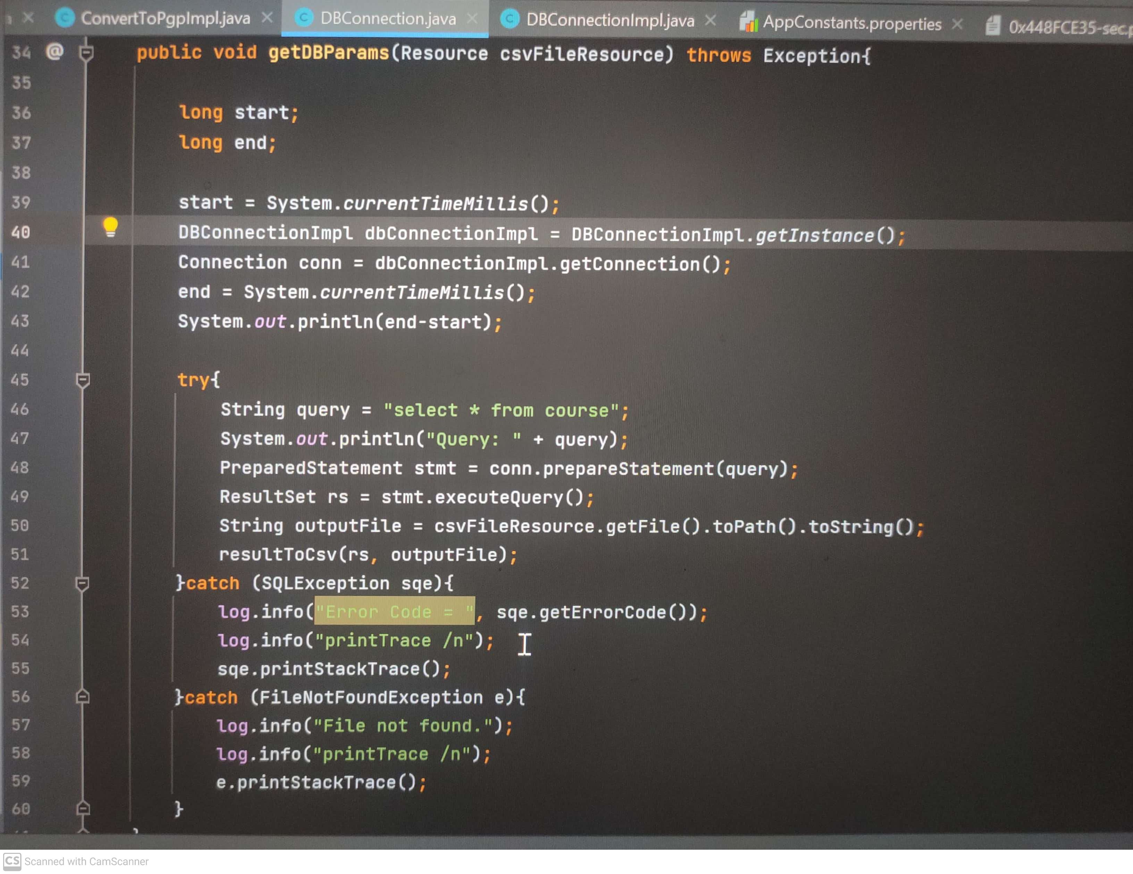
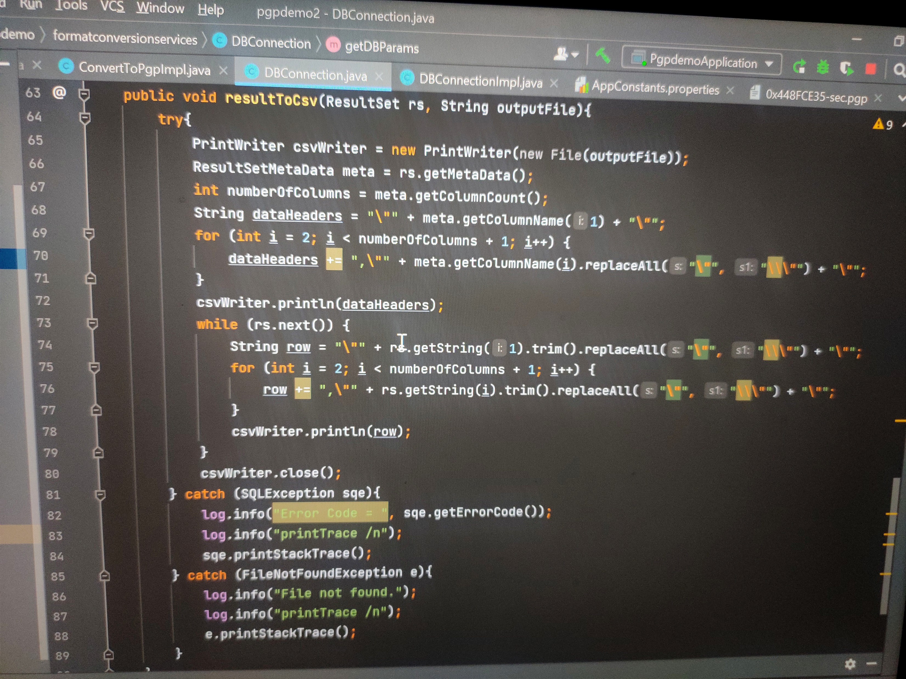
Implementation Of: DB Connection, Query Execution & Writing to CSV File

Slide 15

Achievement & Conclusion
Learned and implemented on loads of new technologies such as Spring Boot, Angular, React etc. and developed various services.
The Data Migration and Encryption Microservice has been pushed to the main branch repository and is under Quality Assurance undergoing testing.
The APP Auto Postage Migration is still in progress. Records are being migrated on a daily basis to the Database after which the entire functionality of the Website would be checked.

Slide 16

Thank you!
EMAIL
btech10083.19@bitmesra.ac.in
CONTACT
933-442-1608

